Slide 1
Guest of Honor
Ceramics 1- Final Project

Slide 2
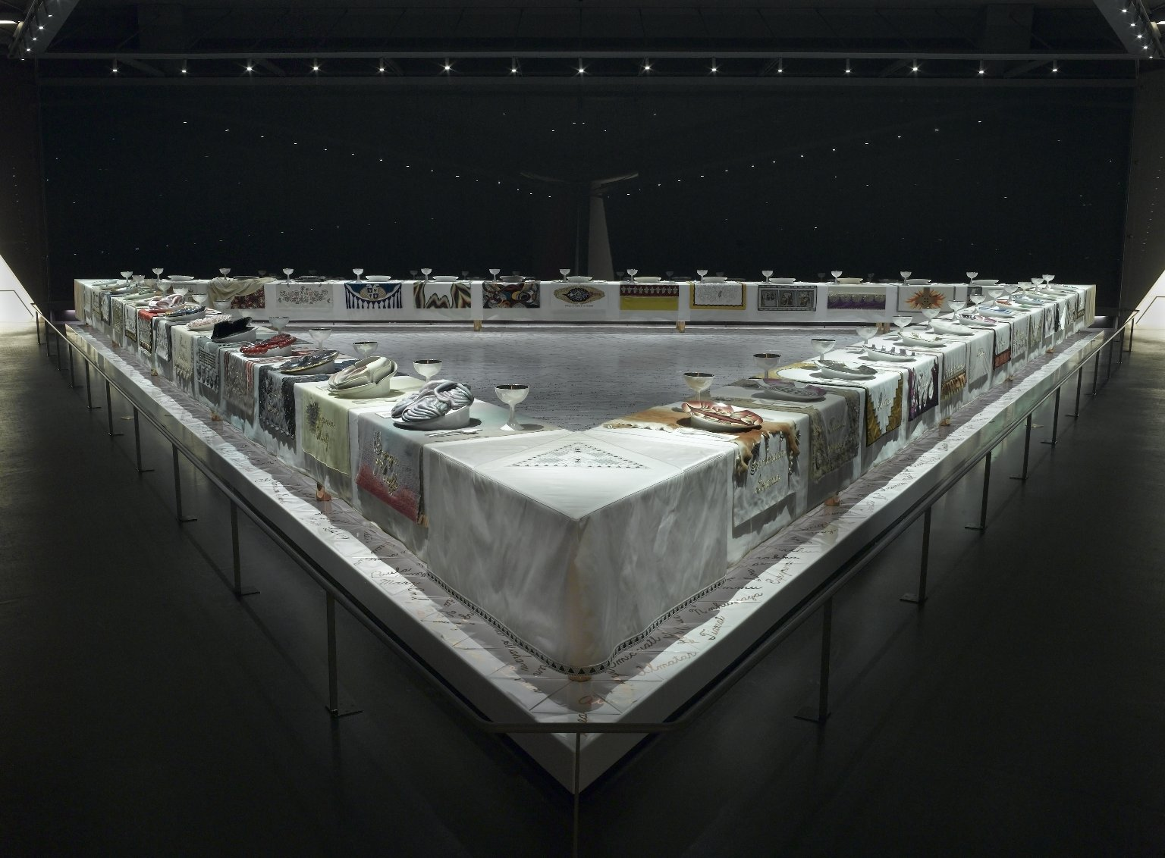
Judy Chicago – “The Dinner Party”
an important icon of 1970s feminist art and a milestone in twentieth-century art

Slide 3
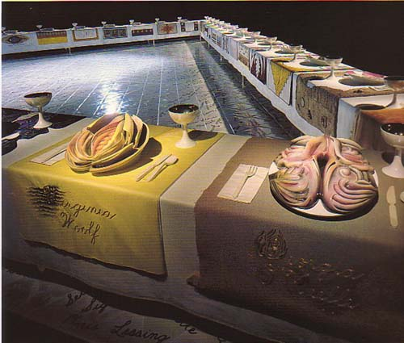
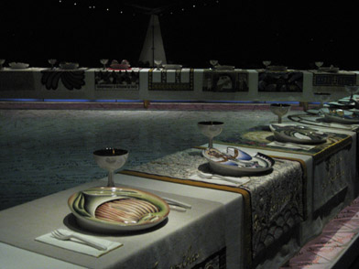
The Dinner Party comprises a massive ceremonial banquet, arranged on a triangular table with a total of thirty-nine place settings, each commemorating an important woman from history.

Slide 4
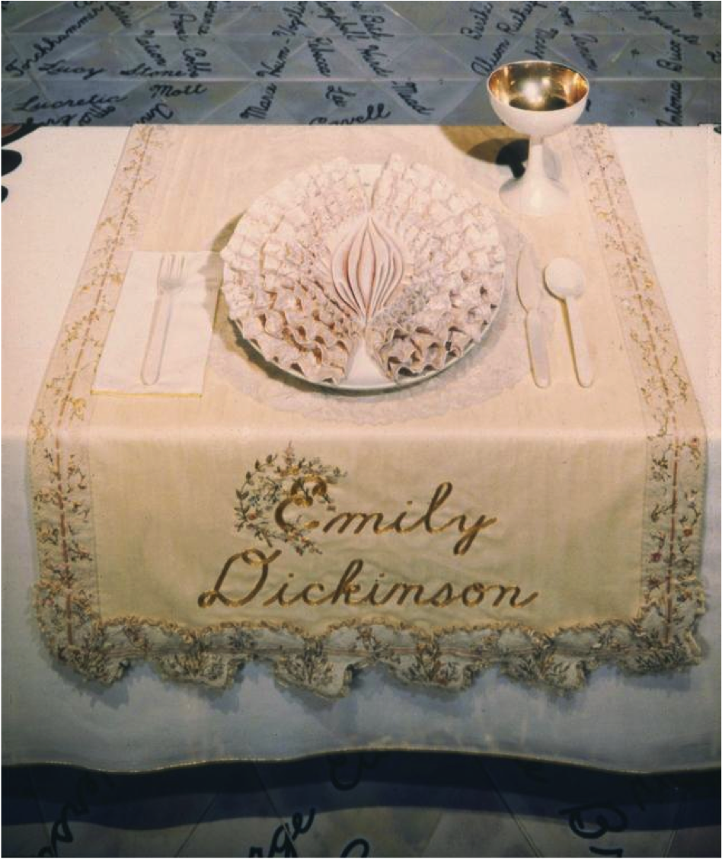
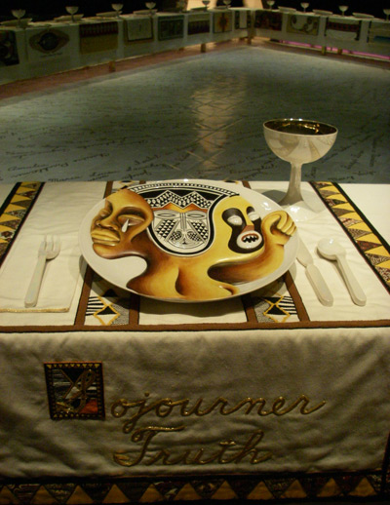

Slide 5
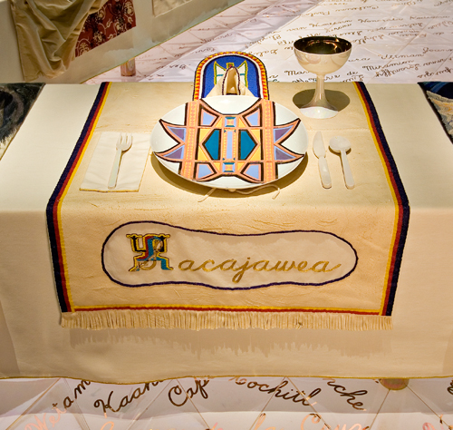
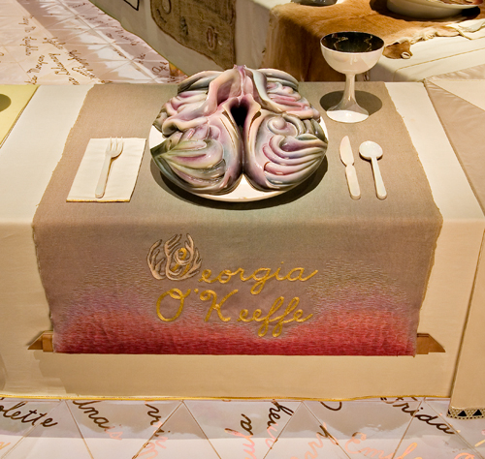

Slide 6
Guest of Honor
Who would you invite?
Inspired by Judy Chicago’s The Dinner Party – choose someone to invite to a meal and create a piece of ceramics to honor that individual.
You can invite anyone… real or imagined, current or ancient, influential or modest
Create an invitation for your guest (to be printed and handed in). Include: date, time and type of meal, reason you invited this individual and any additional information you deem important. Make sure you design your invite in conjunction with the style of your piece.
What will you make? Coffee mug, Tea cup, Sushi set, Dinner plate, Cheese plate, Egg cup..
You may use red or white clay – asses the amounts of each ahead of time.
You may use hand building techniques, throw on the wheel (if possible) or a combination
Do research: sketch, plan, gather visual and written inspiration/information
You must balance Form and Function
Be creative!!!
Be subtle - Avoid clichés

Slide 7
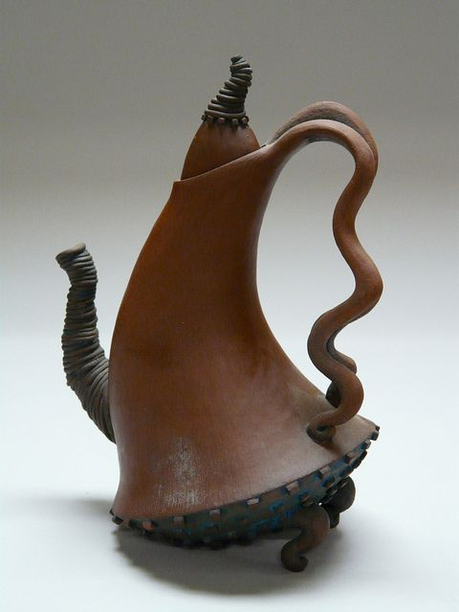
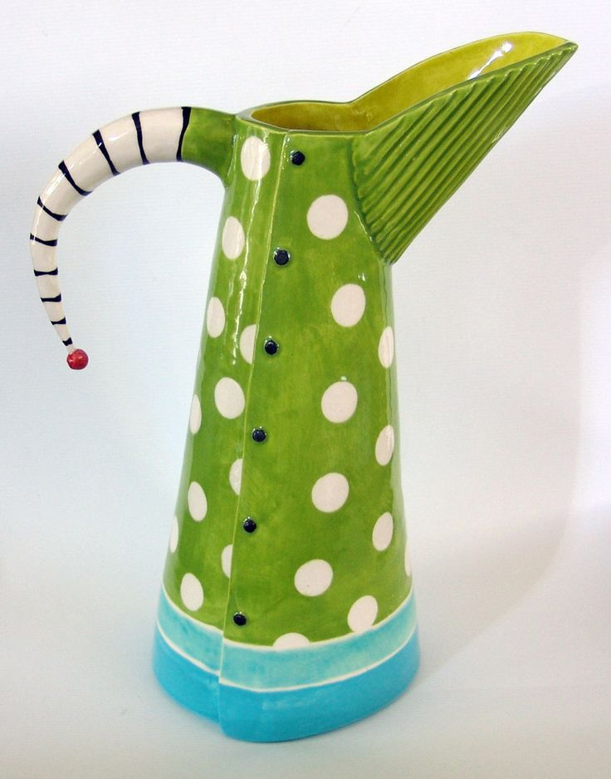
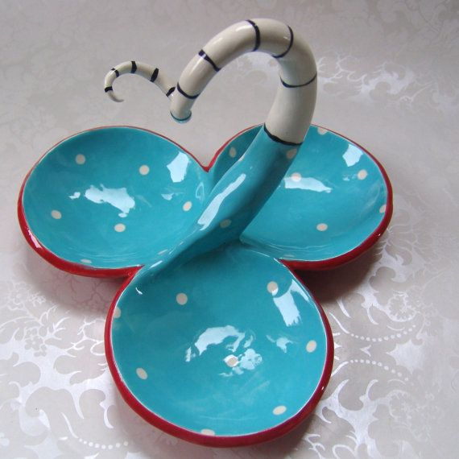
Dr. Seuss

Slide 8
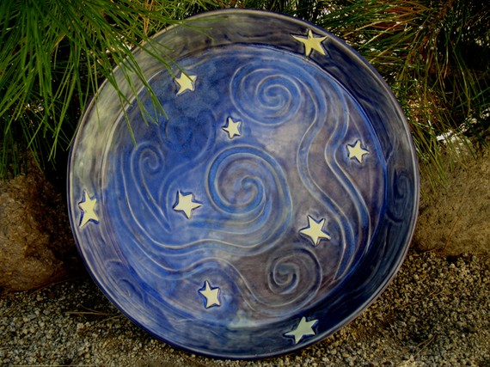
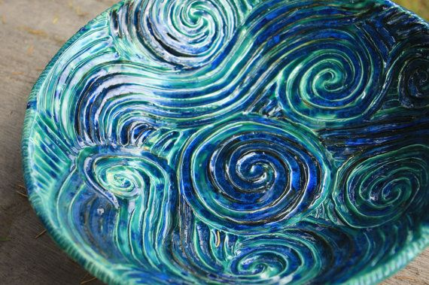
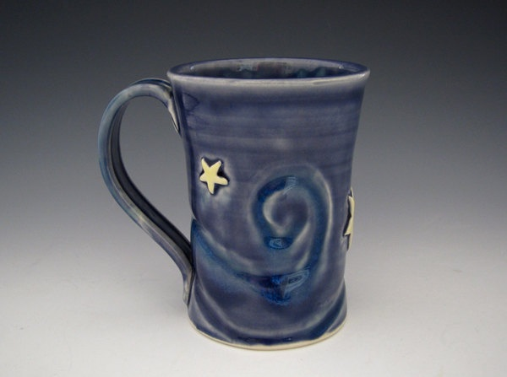
Van Gogh

Slide 9
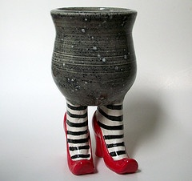
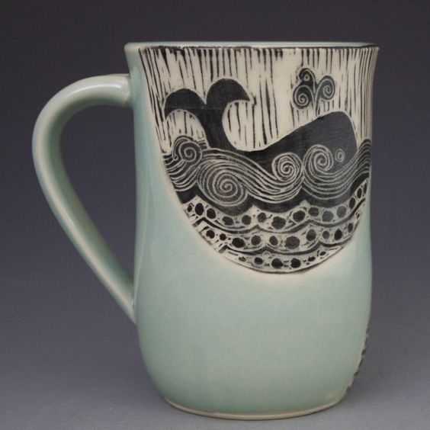
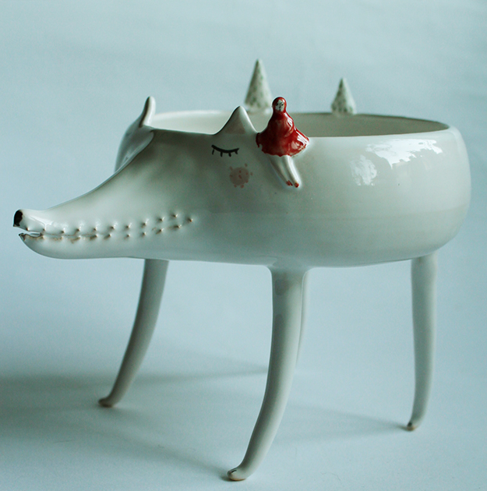
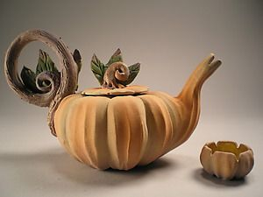
Storybooks Characters

